Slide 1
Taming the Beast
How a SQL DBA can keep Kerberos under control
David Postlethwaite

Slide 2









PLATINUM SPONSOR
GOLD SPONSORS
SILVER SPONSOR
BRONZE SPONSOR
STRATEGIC PARTNER

Slide 3


David Postlethwaite
Liverpool Victoria LV=
SQL and Oracle DBA
MCSE 2014 Data Platform
MCITP 2008, 2005
Oracle OCA
30 years IT Experience
10 years as DBA
david@clunyweb.co.uk
@postledm
linkedin.com/in/davidpostlethwaite
youtube.com/c/DavidPostlethwaiteSQL
Notes:
Welcome
Good Afternoon.
Welcome to this presentation which is entitled “Microsoft Azure for the DBA”
so if you are expecting to hear something else you are in the wrong room.
My name is David Postlethwaite, I am a SQL DBA for a large financial services company on the south coast of England
I have been working as a DBA for the last 10 years
I currently manage both SQL and Oracle instances.
Previous to that I was a developer using .NET, SQL, Access, FoxPro and Oracle
And way back in time I was a Windows and NetWare administrator.

Slide 4
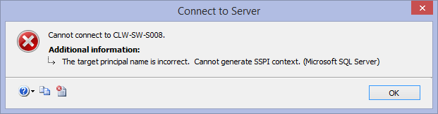
Introduction
Kerberos
What is it?
When do we need it?
How do we configure it?
Who can configure it?
Why does it cause so many issues?
How do we fix it?
4 |
Notes:
Introduction
Kerberos. It’s something that causes lots of problems for many SQL DBAs as well as many Windows Server Administrators.
* I wonder how many of us have seen this error
But configuring Kerberos isn’t that difficult.
What should be a straight forward and simple process can lead to all sorts of issues and trying to resolve them can sometimes be hard work
In this talk we are going to look at Kerberos, how it applies to SQL Server and what we need to do ensure it works
We are going to look at
* What is the purpose of Kerberos in relation to SQL Server?
* When do we need to use it? Do we need to worry about it at all?
* How do we configure it? What tools can we use?
* Who can configure it? Is it the DBA job to manage and configure Kerberos?
* Why does it cause so many issues?
Because on the face of it setting up Kerberos for a SQL Server is actually straightforward but it is very easy to get wrong and then sometimes very difficult to see what is wrong
And finally
* How do we fix it?
When it doesn't work what can we do to try and get it working

Slide 5



My Windows Domain
Active Directory Domain CW1
Cluny10
Domain Controller
clw-sw-s002
service account
cw1\sqlservice8
SQL Server
clw-sw-s006\CW2017
SQL Server
clw-sw-s008
Notes:
Active Directory Domain CW1
Before I look at what Kerberos is, I want to give a scenario where Kerberos authentication is required for SQL Server
Here is a diagram of my Windows setup
I have an Active Directory domain called CW1
A domain controller s002
Two SQL Servers s008 and s006
Both instances of SQL are using domain accounts to run the SQL Server service
My laptop is Cluny10
I am logged in as a domain admin and I have sysadmin permissions on all SQL instances

Slide 6
When do we need it?
The Double Hop Problem
Using desktop SSMS to select data into a SQL instance from another server
select * from openrowset('SQLNCLI', 'Server=RemoteServer Trusted_Connection=yes;’,
'select * from sys.databases’)
Login failed for user ‘NT AUTHORITY\ANONYMOUS LOGON’
X
Cluny10
SQL Server
clw-sw-s008
SQL Server
clw-sw-s006
Notes:
When do we need it?
What we have hit is know as the double hop problem
I can connect from server * s008 directly to server s006 without any trouble at all but I can’t connect from my * desktop * via server s008 to * server s006 because this is trying to do two connections, once from my desktop to s008 and then from s008 to s006
You may also experience similar errors viewing a report in Reporting Services that connects to SQL Server
Here you are connecting from your web browser to the web server and then to the SQL Server. Again a double hop
The only way to fix this is to use Kerberos Delegation
RDP to SQL Server (clw-sw-s008)
I want to insert some data from a text file using bulk insert. On the server I can run
BULK INSERT dbo.table1 FROM ‘c:\data\test1.csv‘
WITH (FIELDTERMINATOR =,',ROWTERMINATOR = '\n')
And it works fine. There are no permissions issues because the data file is local
I can also use a data file on another windows server (clw-sw-s006)
BULK INSERT dbo.table1
FROM '\\clw-sw-s006\data$\test1.csv'
WITH (FIELDTERMINATOR = ',',ROWTERMINATOR = '\n')
And it works fine. There are no permissions issues.
Let’s create a Linked Server to the other SQL Server (clw-sw-s006) and use the security option “Be Made using the login’s current security context”
I can run queries to select data from the linked server without error
I can also use the “openrowset” command to do add-hoc queries from the remote server
Now lets move to SSMS on my desktop connected to SQL server clw-sw-s008
BULK INSERT dbo.table1 FROM ‘c:\data\test1.csv'
WITH (FIELDTERMINATOR = ',‘ ,ROWTERMINATOR = '\n')
Will work fine, the files are on my desktop.
Interesting question. Who needs permissions to the data file? Me or the SQL Server service?
Now lets try inserting data from clw-sw-s006 data file to SQL Server clw-sw-s008
BULK INSERT dbo.table1
FROM '\\clw-sw-s006\data$\test1.csv'
WITH (FIELDTERMINATOR = ',',ROWTERMINATOR = '\n')
And it will fail with this error (assuming file permissions are correct)
Login failed for user ‘NT AUTHORITY\ANONYMOUS LOGON’
Let’s run the query that uses the linked server .
This also fails with the same error
In all cases I can connect directly to server clw-sw-s006 but I can’t connect to clw-sw-s006 via server clw-sw-s008
You may also experience similar errors in these scenarios
Viewing a report in Reporting Services that connects to SQL Server
Using a web application or other front-end applications such as SharePoint that accesses data from a SQL Server
The only way to fix this is to use Kerberos Delegation

Slide 7

NTLM Authentication
Authentication Process
2 “user1”
1 “user1”
password
SQL Server
3 challenge
4 response
hash
5
User1
challenge
response
8
.
6 computes its own response
Domain Controller
7 compares the responses
Notes:
NTLM Authentication Process
So why does our query fail?
We are using NTLM authentication. NTLM was the original authentication method in Windows NT
NTLM uses a challenge/response protocol to authenticate a user.
To keep it simple I’ve missed a few steps
1. * A user logs on at a client computer and provides a domain name, user name, and password.
The client pc computes a cryptographic * hash of the password and then discards the actual password.
* It uses this to login to the Windows domain.
2. * The client now wants to connect to the SQL Server. It sends the user name to the server in plaintext.
3. * The server generates a 16-byte random number, called a challenge and sends it to the client.
4. * The client encrypts this challenge with the hash of the user's password and returns the result to the server. This is called the response.
5. * The SQL server sends to the domain controller:
The User name
The Challenge
The Response
6. * The domain controller looks up the user in Active Directory and then computes its own version the Response from the password hash in Active Directory and the challenge it received from the SQL Server.
7. * The domain controller compares the Response it computed (in step 6) to the response computed by the client (in step 4).
8. * If they are identical, authentication is successful.

Slide 8
NTLM Authentication Double Hop
Why It Fails
2 “user1”
1 “user1”
3 challenge
X
Client
SQL Server
SQL Server 2
.
Domain Controller
Notes:
NTLM Why it Fails
But what happens when the SQL server tries to authenticate to the 2nd Server?
As we’ve just seen when a client wants to use a resource it must go through the challenge
In this scenario the SQL server will try to connect to the 2nd server using the client’s credentials
1. * The user has authenticated to the first SQL Server
2. * The 1st SQL server sends the client’s user name to the 2nd server
3. * The 2nd server generates the 16-byte random number challenge and sends it back to the SQL server.
4. * The 1st SQL server now needs to encrypt this challenge with the hash of the user's password to return to the file server.
But it can’t because it doesn't know what that hash is. That is only held on the client pc and the client pc will not pass it to anything else
* So the connection fails
This is why NTLM fails.
The server cannot authenticate to the next hop without the user’s original password, something which it can’t get.
As a result, the process can only authenticate to the next tier as itself or NULL (anonymous).
Kerberos and its ability to delegate is the solution to this problem

Slide 9


What is Kerberos?
http://web.mit.edu/kerberos/
harrypotter.wikia.com
Created by Massachusetts Institute of Technology, USA
Name is based on the three- headed dog figure from Greek mythology known as Cerberus.
Or possibly Harry Potter
Uses Cryptographic Tickets
More secure and faster than NTLM
Can join Windows to other systems
Notes:
What is Kerberos?
Kerberos is a network authentication protocol developed at the Massachusetts Institute of Technology in the USA in the 1980s.
The name Kerberos is based on the three-headed dog figure from Greek mythology known as Cerberus because there are three parts to the protocol.
* Or possible from Harry Potter (Hagrid owned a Kerberos called Fluffy that guarded the Philosopher's Stone)
Instead of using a challenge, each time a client needs to access a server, Kerberos uses a concept known as * cryptographic tickets.
Kerberos is * faster and much more secure than NTLM and with the threat of hacking and data theft we should be looking to use Kerberos authentication throughout our Windows domain.
From Windows 2012 R2 domains it is now possible to turn off NTLM authentication and I would expect one day that NTLM will be dropped from Windows altogether.
One major advantage of Kerberos authentication * is that you can join Windows domains to other networks such as Unix allowing you to have one password domain covering all your systems.
Interestingly prior to changes in US federal law in 2000, Kerberos was classified by the U.S. government as a munition (i.e. a military weapon) and could not be exported outside the USA.
(Kerberos has been built into Windows 2000 and all versions since)

Slide 10
How Kerberos Works
Key Distribution Centre (KDC)
TGT Ticket Granting Ticket
Domain Controller
Authentication Server
ST Service Ticket
Ticket Granting Service
8 ST
3
7
1
2
TGT
TGT
4
ST
5
9 TGT + ST
TGT + ST
SQL Server
6 data
10 data
10 data
“user1”
.
Client
SQL Server 2
Notes:
How Kerberos Works:
There are three components to Kerberos:
1. * A Key Distribution Center (KDC), which has two parts: an * Authentication Server and a * Ticket Granting Service. In Windows this is a * domain controller
2. * A client or user
3. * A server that the client wants to access
Step 0 – * User enters his login name, password and domain
Step 1 – * The client passes this to the Authentication Server (AS) for verification
Step 2 – * It then grants the client a TGT - A Ticket Granting Ticket.
Think of the TGT as a general admission ticket to the domain. It allows the user permission to get onto the domain but not necessarily access to a specific service
Step 3 – * When the client wants to connect to the SQL Server ,
the client uses its TGT to request a * Service Ticket from the KDC.
Step 4 – The KDC looks up the SQL Server in Active Directory.
If the SQL Server is configured for Kerberos Authentication the Ticket Granting Service * provides a Service Ticket for that SQL Server to the client
Think of this Service Ticket as an admission ticket for a specific service within the domain
Step 5 – * The client can now offer the SQL Server its TGT and this Service Ticket
The SQL server doesn’t need to contact a Domain Controller for verification.
The fact that the client has a TGT and the Service Ticket for this SQL service means that it has already proven its identity to the Domain Controller
And that’s all the server needs to know.
It does not need to know the user’s password
Step 6 – * The SQL Server can now return the data to the client. Assuming it has SQL permissions
One way to think of the TGT and ST is to compare it to a visit to a Theme park. The TGT gives you general access to the theme park for that day. To go on a specific ride you would present your TGT to the pay desk who would then issue you with a ticket specifically for that ride, your ST. You would then go to the ride and present both tickets to prove that you were allowed in the park today and that you have paid to go on the ride.
Step 7 – When the SQL Server sees that it needs to connect to the * 2nd Server it can use the * client’s TGT
Step 8 – * To request a service ticket for that server from the KDC
Step 9 – * With this service ticket the SQL Server can now connect to the 2nd Server using the client’s credentials.
Step 10 – The SQL Server can return the data to the client * *

Slide 11
How Kerberos Works
Why does Kerberos Work?
Doesn’t depend on the user’s password
Just needs a TGT and Service Ticket
Why doesn’t SQL always use Kerberos?
Kerberos is the default protocol
You will login using Kerberos
Many services don’t support Kerberos
Or need manual configuration to work
Notes:
Why (and how) Kerberos succeeds
As you can see Kerberos doesn’t depend on the original user password for authentication.
The only time the original password is used is when the user first logs on and authenticates to the Authentication Server
After that point, authentication to other services is based on the user possessing a Service Ticket for that service
For the SQL server to authenticate to the 2nd Server all it needs is the client’s TGT to get an ST
Why doesn’t SQL always use Kerberos
Kerberos is now the default protocol used by Active Directory.
In a Windows domain you will have logged into your pc using Kerberos authentication.
However many services and applications don’t yet support Kerberos authentication or require extra configuration before they can use it
Every time you login or connect to a server it will always first attempt to use Kerberos and if it can’t it will then revert to NTLM authentication.
In many cases SQL Server requires manual configuration to use Kerberos so in these cases you will use NTLM authentication when connecting to a SQL instance.

Slide 12
Configuring SQL for Kerberos
Done by the Domain Admin not the DBA
or someone with WriteServicePrincipalName Active Directory rights
Service Principle Name (SPN)
SETSPN.exe
serviceclass/
:portnumber
Setspn.exe -s serviceclass/hostname:portnumber serviceAccountName
Setspn.exe -s MSSQLSvc/MySqlServer:1433 mydomain\sqlservice
hostname
serviceAccountName
SPN required for all aliases
Restart SQL
Notes:
Configuring Kerberos
How do we configure Kerberos in Windows?
As I’ve already mentioned Kerberos is the default protocol used by Active Directory.
And your SQL Server may already be using Kerberos authentication without you having to do anything.
If not then you will have to configure it manually.
*To configure a service such as SQL Server to use Kerberos you need to be a domain administrator
or as a minimum have the Write servicePrincipalName permission in active Directory.
So the good news is that Kerberos configuration is probably not done by you, the DBA, but by a Windows or Domain Admin.
In my experience a lot of Windows admins don’t understand Kerberos either so, although you won’t be doing the work, its worth understanding what’s required and, even better, be able to tell your Windows admin what you need.
*To enable Kerberos authentication on our SQL instance we must register a Service Principle Name or SPN for our SQL Server service.
An SPN is a unique name by which a client can identify a service on a particular host.
These SPNs are registered into Active Directory.
Like most complicated things that people struggle to understand, Microsoft has only produced a simple command line tool to configure it ☹
* This tool is setspn.exe.
It should be already installed on your Windows servers. You can install it on your desktop as part of the Remote Server Administration toolkit
* To create an SPN we need four things:
• Service Class: This identifies the general class of service. For SQL Server it is always MSSQLSvc
• Host Name: This is the fully qualified domain name in DNS of the computer that is running SQL Server.
• Port: This is the port number that the service is listening on.
• Service Name The account that is running the service
* If you have aliases for your server, each of those must be registered as well.
* Restart the SQL instance and you will now communicating with your SQL server using Kerberos
And that’s it
The syntax to create an SPN for SQL Server service is
Setspn.exe –s serviceclass/host:portnumber servicename
So for SQL Server it will look like
SetSPN -s MSSQLSvc/clw-sw-s008:1433 CW1\sqlservice2
FYI
Every pc and server automatically has several SPNs running on them. For example whenever a computer is joined to a domain, it is assigned two SPN's called HOST (HOST/netbiosName, and HOST/FQDN.com) These SPNS are used to login to a domain using Kerberos.
(Quick note. Use the latest version of setspn.exe. This is much improved. With this version we can use –s to add a new SPN. NOT –a)
Remote Server Administration Tools for Windows 8.1
http://www.microsoft.com/en-gb/download/details.aspx?id=39296
Setspn Full syntax
https://technet.microsoft.com/en-us/library/cc731241.aspx

Slide 13
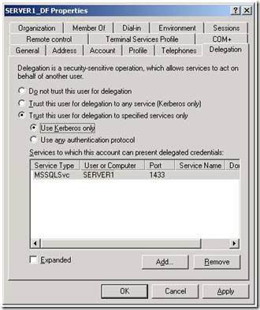
Configuring Kerberos in Windows
Delegation for Double Hop
Active Directory Users and Computers (ADUC)
View/Advanced Features
Delegation Tab
Remote Server Administration Tools
Notes:
Double Hop
To complete the configuration and enable the ability to double hop then you must make one more change.
This is to enable delegation
You can configure this using Active Directory Users and Computers
If you’ve never heard of ADUC, this is the tool that is used to manage user and computer accounts in Active Directory.
Find the service account that is running your SQL Service
Then select the Delegation Tab (This only appears if the account has an SPN and you’ve enabled Advanced features under the View menu)
Select Trust this user for delegation to any service (Kerberos Only)
Or if you want to be more restrictive on what this account can delegate then use
Trust this user for delegation to specified services only
And then enter the spn details for the service you wish your SQL server to connect to
You don’t need to Restart SQL
Even if you aren’t a windows admin or involved in managing user accounts ADUC can be invaluable for checking a user’s permissions in your domain.
It has helped me many times when someone has claimed they can’t get access to a SQL instance and it turns out they aren’t in the required AD group.
ADUC can be downloaded from Microsoft as part of the Remote Server Administration Tools.

Slide 14
Check to see if SQL is using Kerberos
sys.dm_exec_connections
SELECT
s.session_id, s.original_login_name, c.net_transport, c.auth_scheme, c.local_net_address, c.local_tcp_port, s.program_name
FROM sys.dm_exec_sessions s
LEFT OUTER JOIN
sys.dm_exec_connections c
ON (s.session_id = c.session_id)
where s.is_user_process = 1
Notes:
SQL Script to Check Kerberos
How do we check if SQL is using Kerberos authentication?
It wouldn’t be SQL if there wasn’t a DMV to help you
To see what authentication is being used use:
sys.dm_exec_connections
SELECT s.session_id,s.original_login_name, c.net_transport, c.auth_scheme,c.local_net_address,c.local_tcp_port,s.program_name
FROM sys.dm_exec_sessions s
LEFT OUTER JOIN
sys.dm_exec_connections c ON (s.session_id = c.session_id)
where s.is_user_process = 1

Slide 15
DEMO
Create the SPN
Use ADUC to enable delegation
Restart SQL
Rerun SQL script
Notes:
Create the spn using setspn
Set up the delegation using Active Directory users and Computers
Restart SQL
And demonstrate the three hops working

Slide 16
Problems
Duplicate SPN
Use –s instead of –a when creating SPNs.
Or use the 2012 version
setspn – X to look for duplicates
Setspn – L to list SPNs for particular account or computer
setspn – D to delete an SPN
Incorrect SPN
Spelling mistakes
Wrong Server Name – NetBIOS or FQDN
Failing to register the Alias
Missing Port Number
Changing the service account invalidates SPN
Forgetting to enable delegation
Notes:
Problems
If its so simple why do so many people struggle with Kerberos?
* Unfortunately the error messages you receive won’t always tell you that Kerberos is the issue
* The most common mistake used to be creating Duplicate SPNs
It used to be very easy to create the same SPN over and over again. If there are two SPNs, which one is SQL going to authenticate against?
Microsoft has helped here.
In setspn.exe
Originally you used the –a option to create an SPN. This didn’t check for duplicates
Microsoft added “–s” option which does check for a duplicate before it creates the SPN
And now the latest version of setspn the –a option also checks for duplicates so now it is very difficult to create a duplicate SPN.
You can use the –X option to look for duplicates across the whole domain
Use –L to list all SPNs for a particular account. You can use it to list SPNs for a server but it will only list those registered to the local server account, it will not list those using a domain account on that server
You can delete the offending SPN with the –D option
* Incorrect SPN
*Its very easy to type it wrong, it won’t complain about spelling mistakes
Wrong Server Name
Make sure you use the FQDN of the server when you register rather than just the server name
If you are connecting using an alias make sure you register that alias name as well as the server name
And You must register the correct port number as well
Wrong Service Account
The SPN only works for the service account it was configured for. If you change SQL to use a different service account you must delete the old SPN first then create the new one
* Forgetting to turn on delegation
Delegation won’t work if its not turned on

Slide 17
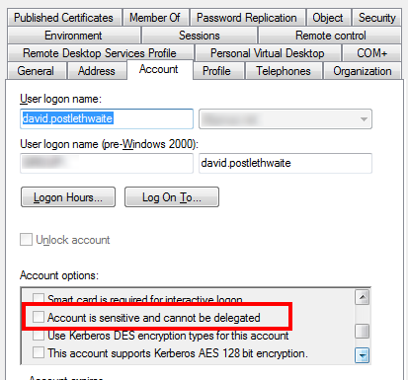
Problems
Forgetting to restart SQL
AD Replication
Stale Kerberos Tickets
klist.exe
Sensitive Clients
Time Synchronisation
Dynamic Port or IP Address
Kerberos not configured on the end Server
Hosts File
BE PATIENT !
Notes:
Problems 2
* Remember to restart the SQL Service after changing an SPN
* Replication
Active Directory can take quite a while to replicate changes to all domain controllers so you may have to be wait a while before it works.
* Stale Kerberos Tickets
Even when everything looks correct it can still not work.
The ticket on your pc may not recognise the new SPN
Klist.exe (part of the Remote Server Administration Tools) allows you to list cached tickets on your desktop and purge them forcing your pc to obtain a new Kerberos ticket
* Sensitive Clients
*In ADUC there is a setting called “Account is Sensitive and cannot be Delegated”
If this is set then your account won’t be able to do the two hops
*Time Synchronisation
Kerberos is time sensitive. If the time is not correct across all servers in the domain then Kerberos may fail ( default 5 mins)
*Dynamic Ports or IP addresses
If the TCP port or IP address then the SPN will have to be deleted and recreated each time.
If you are using a SQL named instance then change the dynamic port to a fixed port to avoid this issue
And ensure your SQL Server has a fixed IP address.
* The End Server
Make sure that the server at the end of the hop is also configured for Kerberos
* Hosts File
If you use a hosts file ensure that the server name use the FQDN. Better not to use a hosts file
* Sometimes you just have to be patient and wait for the changes to take effect.

Slide 18
Automatic SPN Creation
SQL Server is attempting to register a Service Principal Name (SPN) for the SQL Server service.
Kerberos authentication will not be possible until a SPN is registered for the SQL Server service.
This is an informational message. No user action is required.
Permission WriteServicePrincipalName
The SQL Server Network Interface library successfully registered the Service Principal Name (SPN)
[MSSQLSvc/clw-sw-s008.ad ] for the SQL Server service.
The SQL Server Network Interface library could not register the Service Principal Name (SPN) [ MSSQLSvc/clw-sw-s008.cw1.ad.clunyweb.co.uk:1433 ] for the SQL Server service. Windows return code: 0x2098, state: 15. Failure to register a SPN might cause integrated authentication to use NTLM instead of Kerberos. This is an informational message. Further action is only required if Kerberos authentication is required by authentication policies and if the SPN has not been manually registered.
Notes:
Final Thoughts
You may be wondering why we have to go through the pain of creating SPNs manually
Why can’t SQL server just create them automatically?
Well SQL Server can and does.
* By default, when the SQL service starts, it will attempt to register the SPN.
You will see in the error log a message showing SQL trying to register the SPN
* If your service account has permissions to create SPNs * (the WriteServicePrincipalName permission) then it will automatically create an SPN when SQL starts and then automatically delete it when it shuts down.
But if your domain account doesn't have permissions to create SPNs (which is usually the case) then we have to create the SPNs manually

Slide 19
Local Managed Accounts (Local Virtual Accounts)
NT Service/MSSQLServer
Password is managed by the server
Since it is a local account it can register spn automatically
Register the machine
Setspn -s MSSQLSvc/MySqlServer:1433 MyDomain\MySqlServer$“
Notes:
Local Managed Service Accounts
If you are using SQL 2012 or above then its quite likely you are using a virtual account also called a Local Managed Service Account for your SQL Server service.
For SQL Server this is NT Service/MSSQLServer
This account is managed by the server, you do not know the password
Because a Managed Service Accounts is a local account and so is part of the operating system it can register an SPN itself automatically.
Which means that your SQL server will be using Kerberos by default
When you use a locally managed service account the SPN is registered against the server name so when configuring delegation you must configure it against the server
(SQL Server must be running on the Windows 7 or above or Windows Server 2008 R2 and above)

Slide 20
Group Managed Service Accounts (gMSA)
A Domain version of Local Virtual Accounts
Managed Service Account MSA (single server)
Requires SQL 2012 and AD Functional Level 2008 R2
Group Managed Service Account gMSA (multiple servers)
Requires SQL 2014 and AD Functional level 2012 R2
Password managed by Key Distribution Service (KDS)
gMSA is the best choice for Always On and cluster service accounts
It takes a bit of effort to setup. Definitely something for Domain Admins to build
Must use PowerShell to build them
https://www.mssqltips.com/sqlservertip/5340/using-group-managed-service-accounts-with-sql-server
Notes:
Managed Service Accounts and Group Managed Service Accounts
A much better choice for your service account is something called a group managed service account
This is a user and a computer at the same time.
Unlike the previous Local Virtual Accounts these are held in Active directory and the password are generated and maintained by the Key Distribution Service (KDS)
(gMSAs use a complex, automatically generated password (240 bytes, which is 120 characters, and cryptographically random). )
gMSAs cannot be locked out, and cannot perform interactive logons
Active Directory automatically can update the group managed service account password without restarting services.
A Managed Service Account (MSA) is assigned to a single member computer. It requires AD Functional Level 2008 R2
It is supported on SQL 2012 and above
A Group Managed Service Account is an MSA for multiple servers. It requires AD Functional Level Server 2012 R2
Supported on SQL Server 2014 . Can be used on standalone instances, failover cluster instances, and availability groups.
(g)MSA has the ability to register Service Principal Name (SPN) with the Active Directory.
(Though this is not always the case. We had issue on a new gMSa where it didn’t have the right permissions
We had to run dsacls <gMSA> /G SELF:RPWP;"servicePrincipalName" before it would allow SQL to create the SPNs)
To setup requires PowerShell and I can take a quiet a bit of time to setup a GMSA.
A (g)MSA is named with a $ suffix, for example DOMAIN\ACCOUNTNAME$.
Create KDS Root Key using PowerShell – this can take hours
Create an AD Security group
Add all the servers that want to use the GMSA to the security group
Create gMSA and specify the Security Group to link the account and computers
See this link by John Martin for full instructions
https://www.mssqltips.com/sqlservertip/5340/using-group-managed-service-accounts-with-sql-server/

Slide 21
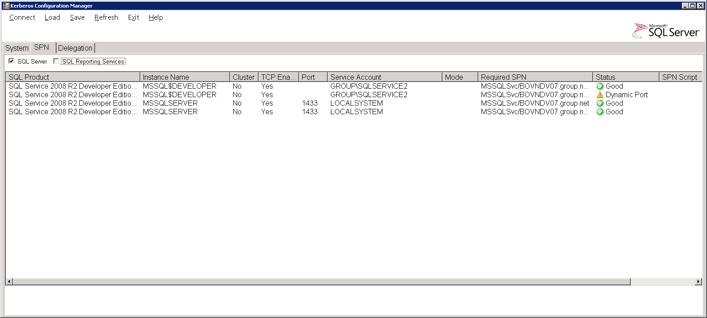
Kerberos Configuration Manager for SQL Server
http://www.microsoft.com/en-gb/download/details.aspx?id=39046
Or
https://blogs.msdn.microsoft.com/sqlreleaseservices/category/kerberos-config-tool/
Latest version is 4.1 Supports SQL 2017
No Start Menu Item Created
\Program Files\Microsoft\Kerberos Configuration Manager for SQL Server
Notes:
Making the Job Easier
You may remember I said that there was only a command line tool for managing your SPNs
Well Microsoft have developed a graphical tool especially for SQL Server called
Microsoft Kerberos Configuration Manager for SQL Server
And it’s really, really good.
This will tell you what SPNs are missing or duplicated for your SQL instance.
and it will even write the setspn scripts for you to give to your Windows admins
This is a must have for any SQL DBA dealing with Kerberos
Latest version is v4. This supports SQL 2016 and 2017 and below, DBMS, SSRS and SSAS instances
Previous version is v3. This supports SQL 2014 and below, DBMS, SSRS and SSAS instances.
Note – I found a bug in v3. if you only have SQL 2012 or below installed it won’t find them. It uses WMI to find the SQL servers. V3 looks in the location where SQL 2014 would be so can't find any previous versions
V2 supports 2012 and below DBMS and SSRS. It doesn’t recognise SQL 2014 instances.

Slide 22
Other Tools
PowerShell DBATools
https://dbatools.io/schwifty/
ADSIEdit
GUI to view details of AD objects including SPNs
Dsacls
Command line tool for listing and setting parameters of Ad objects
Klist
Command line tool for viewing and purging local tickets
Notes:
Other tools
DBATools is a huge suite of PowerShell scripts written by the SQL community. I highly recommend you take a look at them. There are command available that can help with Kerberos configuration
ADSIEdit, Dscacls and Klist are part of the Remote Server Administration toolkit and can be helpful in resolving Kerberos issues

Slide 23
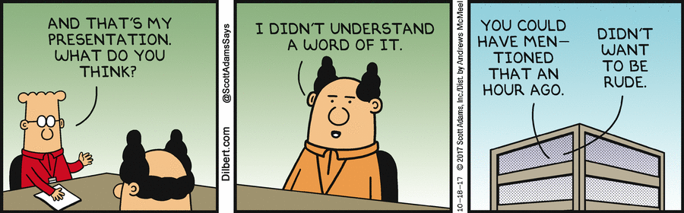
Any Questions
Conclusion
Hopefully you now have a better understanding of Kerberos
And will be able to use it safely in your environment
www.youtube.com/c/DavidPostlethwaiteSQL
@postledm
david@clunyweb.co.uk
Notes:
Any Questions
Hopefully you now have a better understanding of Kerberos
And will be able to use it safely in your environment
Useful Article
http://blogs.msdn.com/b/saponsqlserver/archive/2013/05/03/faqs-around-kerberos-and-sql-server.aspx
SSRS
We haven’t mentioned Reporting Services but this is often where the double hop is required. You can be hopping from Web Browser to Web Server to SQL database .
This link http://sqlmag.com/sql-server-reporting-services/implement-kerberos-delegation-ssrs
provides a very good explanation of Kerberos and SSRS.
Also Kerberos Configuration Manager also supports SPNs for the SSRS service.

Slide 24
PLATINUM SPONSOR
GOLD SPONSORS
SILVER SPONSOR
BRONZE SPONSOR
STRATEGIC PARTNER

